Slide 1
PYTHON PROJECT

Slide 2

MINI BANKING SYSTEM
BY:
Pavan Marturu
Guided by: Prof. Weihua Zhou

Slide 3

AIM & MAJOR APPLICATION
The main intention of doing this project is to minimize the amount of time spending for a person to open an account at bank, a person often needs to go there, complete the relevant paperwork, and fill out a form.
These activities all take a lot of time and hinder the general client experience. In addition, many consumers must take time away from their busy schedules to visit a bank.
This issue can be resolved by developing a software that enables individuals to easily and digitally open new bank accounts.
The individual would save a great deal of time and effort by avoiding the need to physically visit the bank in this manner.

Slide 4

FRAME WORK USED
Prerequisite: Python GUI tkinter, MySQL database
Python for creating websites and applications, automating tasks, analyzing data, and visualizing data. SQL database to store the information about the user which gets updated in real time. All common python distributions include the Tkinter library, which is used to build graphical user interfaces (GUIs) for the project

Slide 5
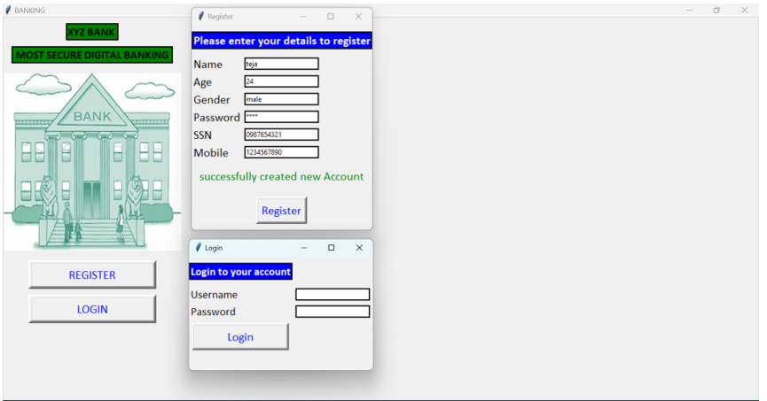
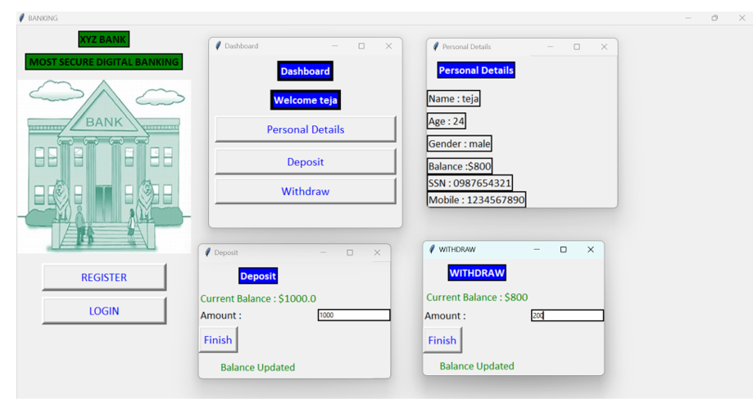
USER INTERFACE
Input - Upon entering the basic details of customer like username, age, gender, SSN and password, which will eventually stored in the database, with this method customer can create bank account without any hustle.

Slide 6

CHALLENGING PART OF THE PROJECT
The most challenging part for me during this project is making styles, layouts for the buttons and making the connection of the data which ever entered in the fields to the database.

Slide 7

THANK YOU

